Slide 1
DEEP LEarNiNg MastEr Class
Day-21

Slide 2
Announcement
Attendance Link will be Available around 8:30 PM

Slide 3
01
Image Segmentation
Concept

Slide 4
Pixellib
Pip install pixellib
PixelLib Python library here which has been built for performing segmentation of images and videos with much ease.

Slide 5
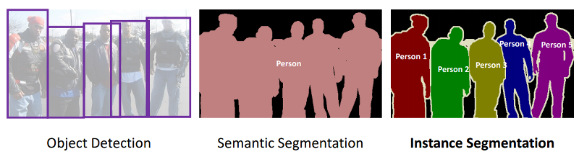
Segmentation
It segments the visual input in order to process it for tasks such as image classification and object detection
Segmentation methods can be classified into three categories viz.
Semantic segmentation
Instance segmentation
Panoptic segmentation

Slide 6
Semantic segmentation
Semantic segmentation associates every pixel of an image with a class label such as a person, flower, car and so on. It treats multiple objects of the same class as a single entity

Slide 7
Instance Segmentation
Semantic segmentation associates every pixel of an image with a class label such as a person, flower, car and so on.
It treats multiple objects of the same class as distinct individual instances.

Slide 8
panoptic segmentation
To combine the concepts of both semantic and instance segmentation, panoptic segmentation assigns two labels to each of the pixels of an image – (i)semantic label (ii) instance id. The identically labelled pixels are considered belonging to the same semantic class and instance their id’s distinguish its instances.
We have used MS-COCO dataset, PyTorch Python library and Detectron2 (a PyTorch-based modular library by Facebook AI Research (FAIR) for implementing object detection algorithms and also a rewrite of Detectron library).
We can also use DETR (DEtection TRansformer) framework introduced by FAIR.
Types
Detectron
Detectron2
DETR

Slide 9
Deep Learning Terminology - 1
ESA (Explicit Semantic Analysis)
Used in Information Retrieval , Document Classification and Semantic Relatedness Calculation (I.e How Similar in Meaning two words or Pieces of text are to each other )
ESA is the process of understanding the meaning of a Piece text , as a Combination of the concepts found in that text.

Slide 10
Deep Learning Terminology - 2
LSA ( Latent Semantic Analysis )
The process of analyzing relationships between a set of documents and the terms they contain.
Accomplished by producing a set of concepts related to the documents and terms.
LSA assumes that words that are close in meaning will occur in similar pieces of text.

Slide 11
Deep Learning Terminology - 3
LDA (Latent Dirichlet Allocation)
A common topic modeling technique, LDA is based on the premise that each document or piece of text is a mixture of a small number of topics and that each word in a document is attributable to one of the topics.

Slide 12


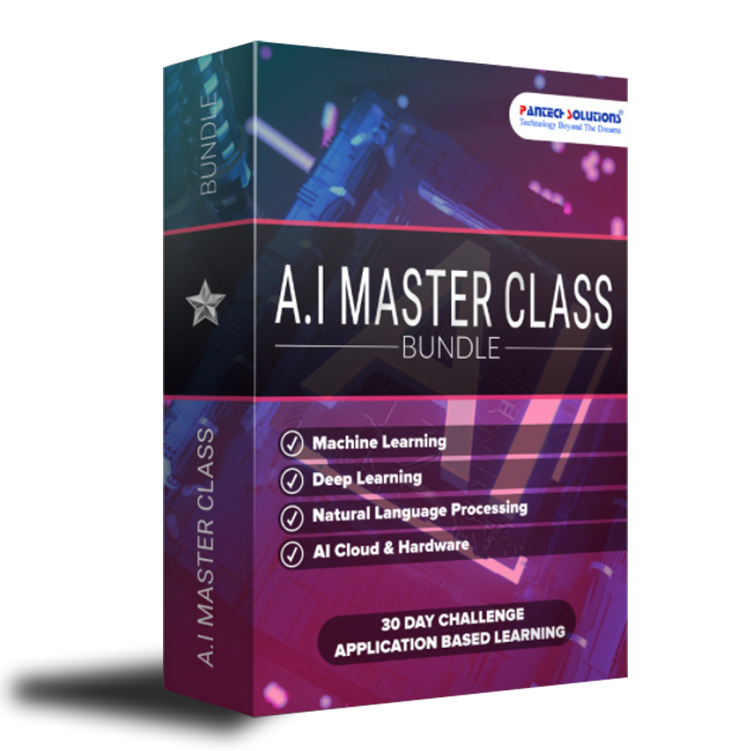


3 in 1 Internship
Total Value
₹1,14,000
OFFER
₹999
Access to 90 Days Video Lectures (Value ₹12,000)
70+ Projects - From Scratch (Value ₹75,000)
100+ Source Code (Value ₹10,000)
Technical Materials (PPT & Mindmap) (Value ₹10,000)
Bonus Task, Assignment(Value ₹5,000)
Forum Telegram discussion & Support (Value ₹2,000)
3 Internship E-Certificate(A.I & M.L & D.A)

Slide 13
Quotes
Short bytes – D21
If you understand others you are smart.
If you understand yourself you are illuminated.
If you overcome others you are powerful.
If you overcome yourself you have strength.
If you know how to be satisfied you are rich.
If you can act with vigor , you have a will.
If you don’t lose your objectives you can be long lasting.
If you die without loss you are eternal.

Slide 14
Q & A Session

Slide 15
Thanks!
Thanks!
Follow Me on LinkedIn : Link in Description
+91 7305845758
Pantechsolutions.net
Ask Your Friends to Participate on this Event

